Slide 1



Parallel Convolutional Neural Network-based Transient Stability Assessment
CS 6230 Project Presentation
Nicole Hao Jerry Feng
yh397@cornell.edu zf245@cornell.edu

Slide 2
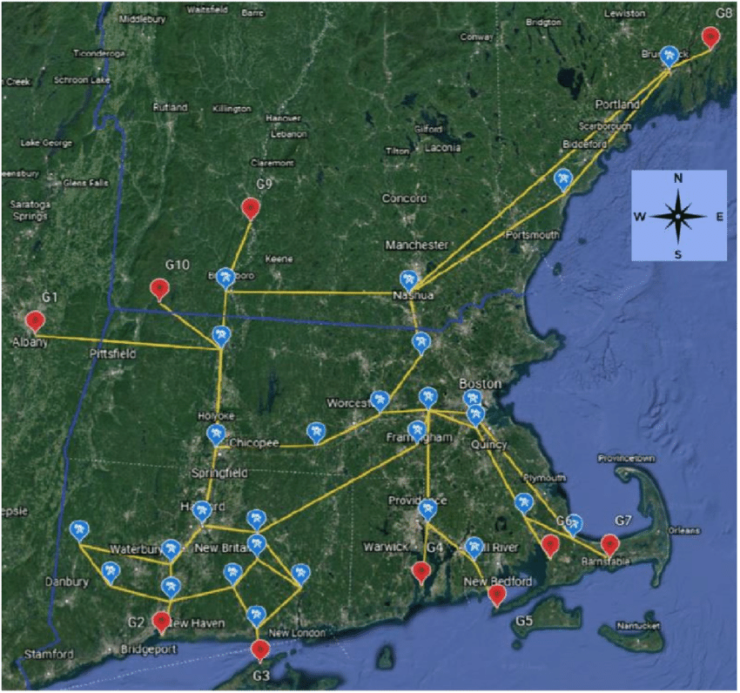
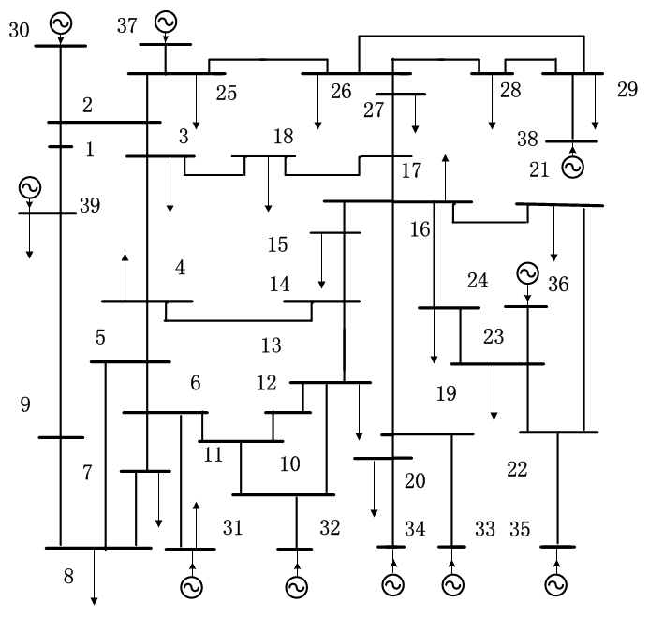
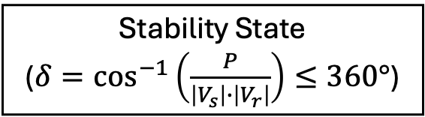
Introduction & The Need for Parallelization
Power network as a graph:
Generation Node – Transmission Node – Demand Node
Features: power, voltage, angle, rotor speed, etc.
Transient stability assessment – when it doesn’t work:
A power system’s response to sudden disturbances
Varying generation/load, generator outage, short circuits…
Fault clearing does not always happen promptly (> 200ms)
Million-dollar question:
Multi-channel time series classification that is accurate and fast
Frequently re-trained with new disturbance/status
Immediate (<1s) post-fault features time series
Stability State
($δ=\cos^{−1}\left(\frac{P}{\left|V_{s}\right|∙\left|V_{r}\right|}\right)≤360°$)

Slide 3
Motivation & Project Goals
Accurate Algorithms are Slow
Pattern-recognition classifiers (e.g., SVM)
PDE-based time domain simulation
Fast Algorithms are not accurate
Existing ML/DL-based approaches
Cannot run rolling assessment w/ new data points
Limited Benchmarking
No scalability testing
Most literature focus only on the accuracy but not training time
Other Research Gaps
No end-to-end open-source implementation
A parallel CNN-based transient stability assessment algorithm with:
Comparable accuracy to state-of-the-art existing implementations on real-world dataset
Parallelized training for significant training time reduction
Scaling test
Notes:
Interpolating the performance of unseen graphs from a set of discrete graphs with no common continuity feature is challenging.

Slide 4
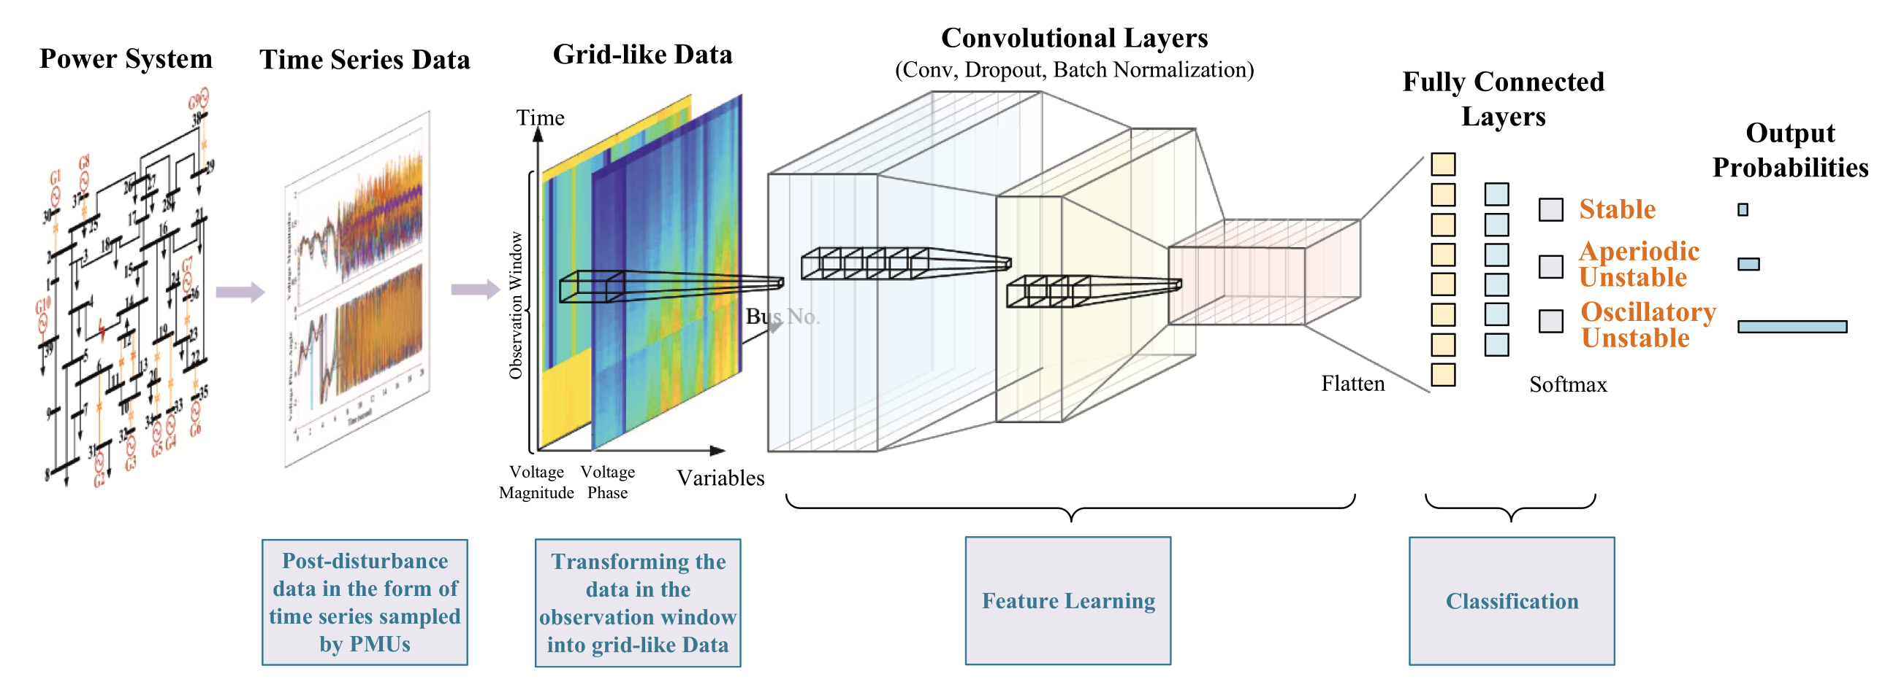
Data & Setup
New England 39-bus system with 10 generators, each with 5 channels
80-120% generation/load profile, three-phase short circuit faults cleared from 0.1-0.3s
most severe (create the highest disruptive currents) and included in any planning and protection study
12852 sets of data classified as 1 (stable, 58%) and 0 (unstable, 42%)
Z. Shi, W. Yao, L. Zeng, J. Wen, J. Fang, X. Ai, J. Wen. (2020). Convolutional neural network-based power system transient stability assessment and instability mode prediction. Applied Energy, Volume 263, 114586.
Sokolović, Živko (2024), “Dataset for Transient Stability Assessment of IEEE 39-Bus System”, Mendeley Data, V1, doi: 10.17632/p992nhb8ss.1

Slide 5
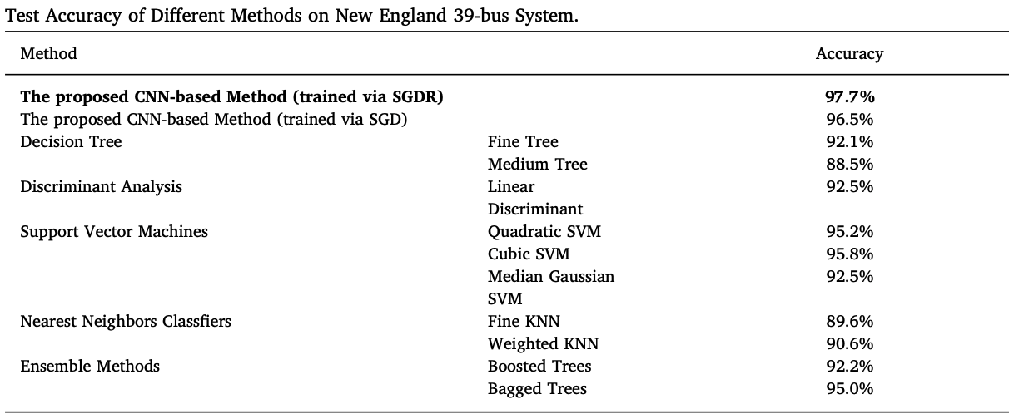
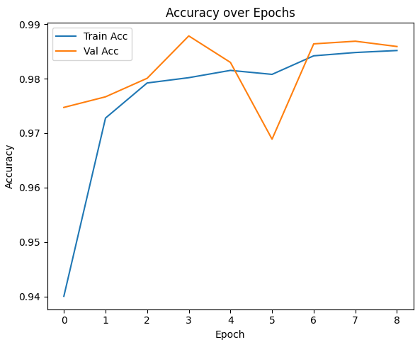
Preliminary Results: Accuracy
Our model achieved a testing accuracy of 98.8% on the NE 39-bus system
Improvement over older NN-based (Z. Shi et al., 2020) and on par with existing multi-channel CNN-based algorithms (C. Shi et al., 2022)
Batch normalization is used to improve speed, performance, and stability
Lower requirement on data availability (only 10 generator buses instead of all 39)
C. Shi, J. Liu, Z. Liang et al. (2022). Transient Stability Assessment of Power System Based on GAN and Multi-channel CNN. Power System Technology. Vol. 46, No.8, 1000-3673 (2022) 08-3191-12
Z. Shi, W. Yao, L. Zeng, J. Wen, J. Fang, X. Ai, J. Wen. (2020). Convolutional neural network-based power system transient stability assessment and instability mode prediction. Applied Energy, Volume 263, 114586.

Slide 6
Preliminary Results: Training Parallization
Data‐Parallel Batch Splitting
Use tf.distribute.MirroredStrategy()
Automatically shards each Keras batch across all available GPUs
Optionally scale logical batch size by num_replicas_in_sync to keep per-GPU batch constant
Im2Col Convolution Optimization
Replace standard Conv2D with a custom Im2ColConv2D layer
tf.image.extract_patches → reshape → GEMM → reshape back
Leverages high‐efficiency matrix multiplications on each GPU
Gradient AllReduce
Wraps the optimizer to average gradients across replicas
No manual synchronization code needed for fully-connected layers
Ensures consistent weight updates as if training were on a single device
S. Lee, D. Jha, A. Agrawal, A. Choudhary and W. -k. Liao, "Parallel Deep Convolutional Neural Network Training by Exploiting the Overlapping of Computation and Communication," 2017 IEEE 24th International Conference on High Performance Computing (HiPC), Jaipur, India, 2017, pp. 183-192, doi: 10.1109/HiPC.2017.00030.

Slide 7
Next Steps, Limitation & Future Work
Validate scaling by measuring images/sec as you add GPUs
Tune batch size and learning rate
Experiments on larger systems (e.g., Polish 2383 bus) to study the scalability and potential overheads
Multi-class classification e.g., oscillatory vs. aperiodic unstable
Other NN architecture for higher accuracy
Graph Neural Networks to directly encode bus connectivity
CNN + GAN implementation shows better accuracy from literature
Beyond data-parallelism?
C. Shi, J. Liu, Z. Liang et al. (2022). Transient Stability Assessment of Power System Based on GAN and Multi-channel CNN. Power System Technology. Vol. 46, No.8, 1000-3673 (2022) 08-3191-12
Notes:
For larger graphs/ more complex operations, would the overhead outweigh the possible optimization that we can get out of the results?

Slide 8

Thank you!
Jerry Zhuoer Feng
zf245@cornell.edu

